Slide 2
About AMCC
AMCC’s mission is to represent its members at national and international level, to promote the concept of credit services management and support it in the national legislation.
AMCC wants to be a national representative association for debt collection agencies in Romania and to implement a high standard of quality in the management of receivables.
AMCC’s scope:
The main purpose of AMCC is to regulate the profession and to set professional ethical principles to be followed by debt collection companies in relation to retail and corporate debtors.
Since its establishment, AMCC is a full member of FENCA – Federation of European National Collection Associations.
Through AMCC, Romania became the 15th Member of FENCA.

Slide 3
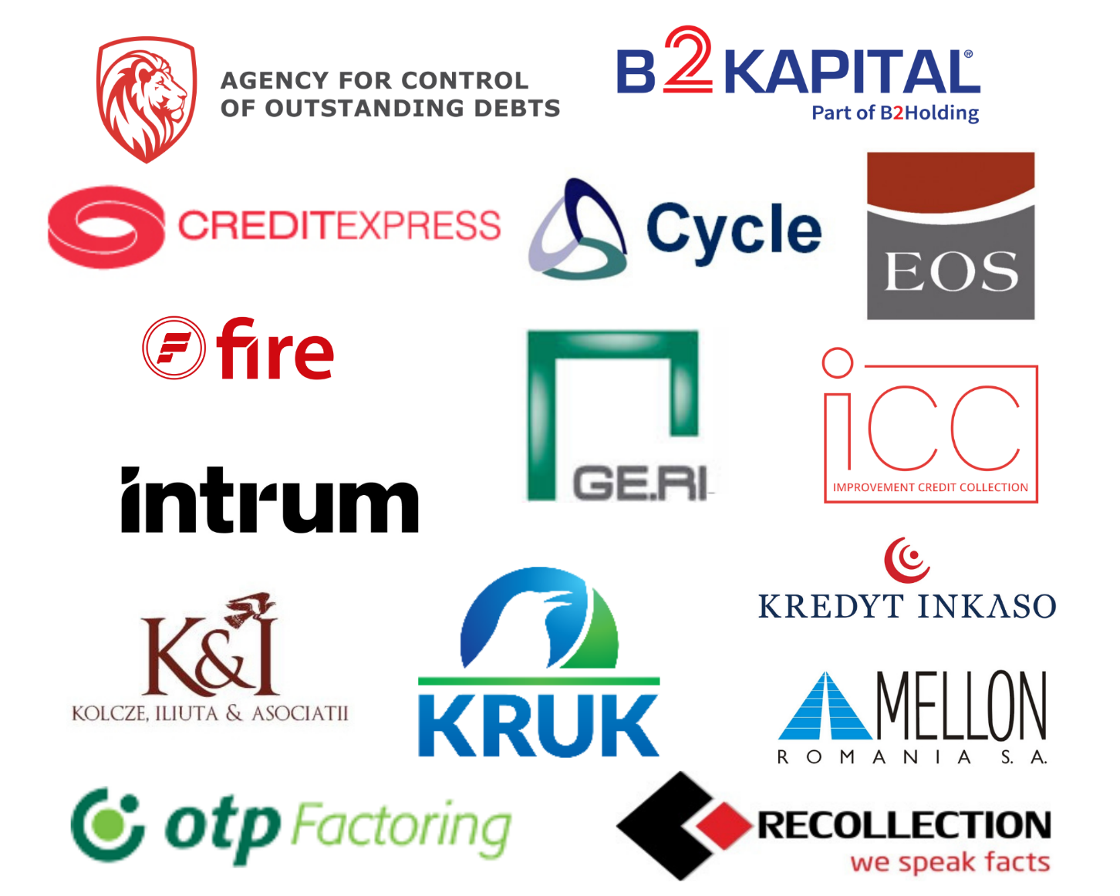
Members AMCC
AMCC was founded in 2007 at the initiative of Coface, EOS KSI and Creditreform.
Currently it brings together 15 members.

Slide 4
Agenda
What is debt collection?
Debt collection market evolution and trends in 2021
Romanian B2C debt collection market:
B2C – Serviced debt
B2C – Purchased debt
Romanian B2B debt collection market
Debt collection market for international clients
Macroeconomic environment
Continuous improvement measures

Slide 5
What is debt collection?
Why do companies choose to externalize debt collection?
A possible answer would be due to legislation (e.g.: prudential rules regarding non-performing loans), cash flows constraints and decisions to increase operational efficiency can lead to debt collection externalization.
A debt collection agency acts as an intermediary between a debtor and a creditor. It can facilitate a payment schedule for the debtors.
Debt collection agency
A creditor can have two categories of clients, B2C and B2B.
B2C clients are natural persons (e.g. people who have a telecom subscription, etc.)
B2B clients are legal persons (e.g. companies/NGOs that receive loans from banks, etc.)
Creditor
Debtor
/
The communication between the collection agents and the debtors is the quickest and easiest way to solve the debt situation under conditions that are favorable to all parties.

Slide 6
Debt collection process
Who are the companies (creditors) that refer collection of debt?
How is debt transferred to debt collection companies?
What does this mean for the debtor?
Creditor
Rights over the debt are referred to a debt collection agency or a consortium of companies.
Collection is taken over by the company which owns the rights over the debt.
Banking institution
Telecom companies
Leasing
Insurance
FMCG
Universities
Pharma etc.
Purchase rights for the debt (Debt purchased)
Collection based on success fee (Debt Serviced)
Rights over the debt are kept by the creditor
Debt collection operations are performed by the contracted company, in return receiving a fee, according to the service agreement.
Who is a debtor?
How is the debtor contacted?
What is the general approach?
Debtor
Natural persons (employees, students, etc.)
Legal persons (limited liability company, corporations, etc.)
Discussions with the debtor include:
Identify solutions for payment of debt;
Decide on the best option for both the debtor and the creditor;
Agree and sign a written agreement based on previous discussions.
Phone calls
E-mail
Written correspondence
Field activities

Slide 7
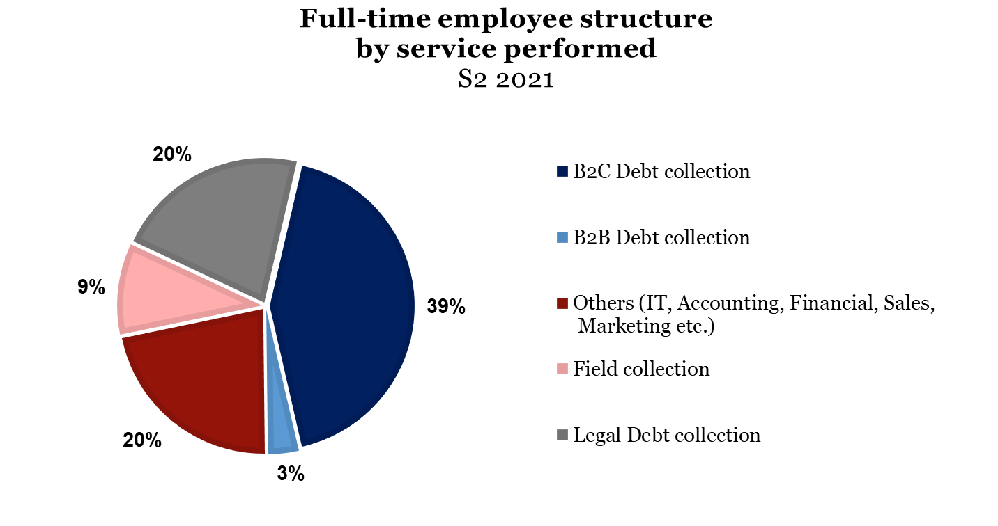
The Romanian debt collection industry employs ~1800 people, almost half of them being in the B2C & B2B collection segment
Employee structure
B2C debt collection is the most employee-intensive function, accounting for approx. 39% of the total full-time employees.

Slide 8
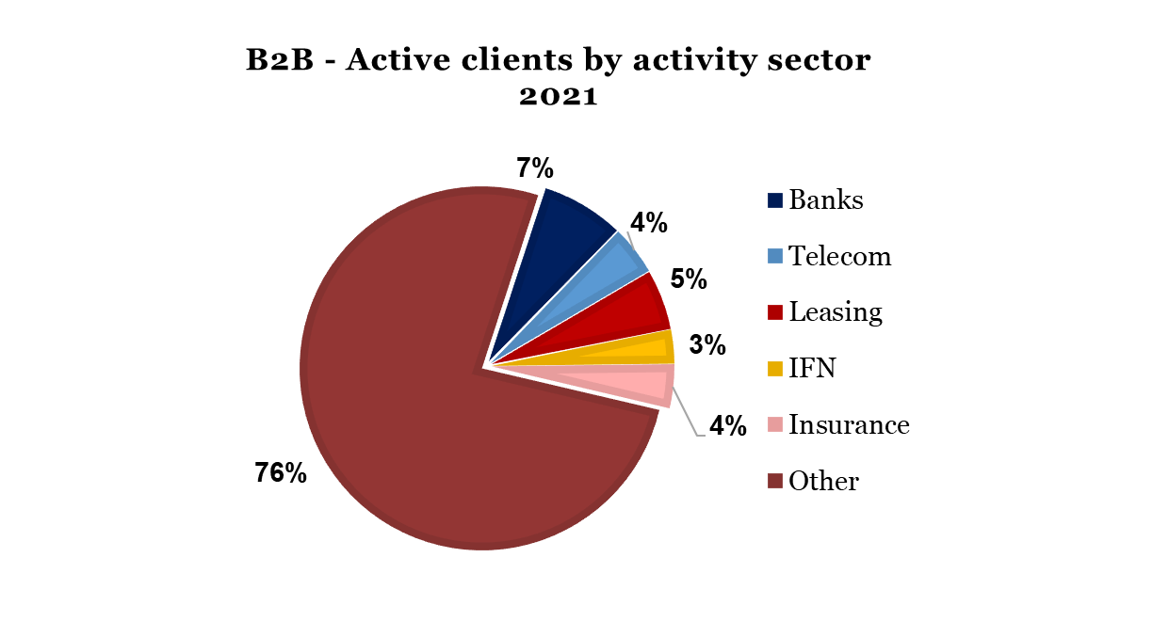
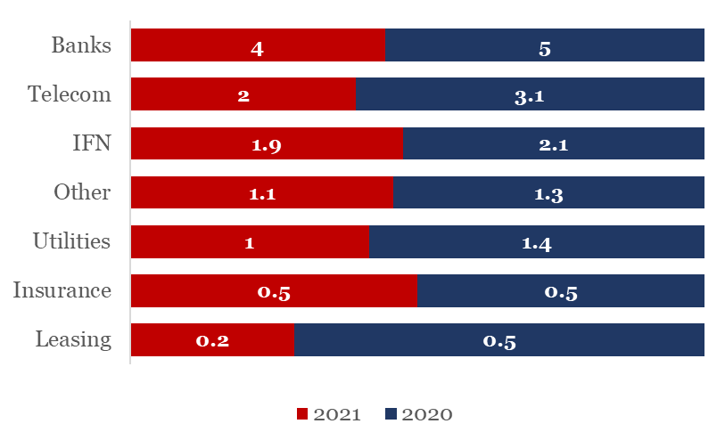
In 2021, the total number clients has decreased compared to 2020, with a relatively similar industry structure.
Active clients
B2C – Average clients per respondent 2021
B2C segment: The number of active Banking and Telecom clients has decreased in 2021 compared to 2020.
B2B segment: Most of the active clients come from other industries such as FMCG, Pharma, IT, Distribution, with a low representation from Banking, Telecom and Leasing sectors.
In 2021, 62% of B2C active clients were fr0m the financial services sector (Banking, NBFI, Insurance and Leasing), a slight increase from 2020.
*Number of active clients was calculated at AMCC level
**One client does not necessary account for a client, as a creditor can request collection services from more than one collection agency.

Slide 9
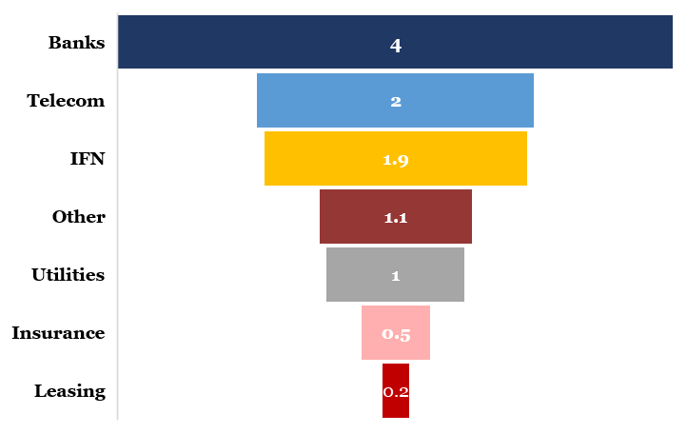
Banking sector is the main provider of clients in 2021
Active clients
B2C – Average clients per respondent 2021
B2C segment: The number of active Banking and Telecom clients has decreased in 2021 compared to 2020.
B2B segment: Most of the active clients come from other industries such as FMCG, Pharma, IT, Distribution, with a low representation from Banking, Telecom and Leasing sectors.
In 2021, 62% of B2C active clients were fr0m the financial services sector (Banking, NBFI, Insurance and Leasing), a slight increase from 2020.
*Number of active clients was calculated at AMCC level
**One client does not necessary account for a client, as a creditor can request collection services from more than one collection agency.

Slide 10
Agenda
What is debt collection?
Debt collection market evolution and trends in 2021
Romanian B2C debt collection market:
B2C – Serviced debt
B2C – Purchased debt
Romanian B2B debt collection market
Debt collection market for international clients
Macroeconomic environment
Continuous improvement measures

Slide 11
Executive Summary (1/1)
Debt collection market in 2021
Romanian B2C debt collection market – Serviced debt.
Compared to 2020, in 2021, serviced debt outsourced fell by 7% in terms of debt value, and by 40% in terms of number of cases.
The value recovered from B2C cases and returned into the economy by debt collecting companies was ~91 mil EUR, a ~43% decrease compared to 2020.
Average value per case for serviced debt outsourced in 2021 was 212EUR/case, while for debt recovered was 78 EUR/case.
The most important sector in terms of number of cases outsourced for 2021 remained, as in 2020, the Telecom sector.
Romanian B2C debt collection market – Purchased debt.
The value of purchased debt sold decreased by 26% in 2021 compared to 2020.
Average value per case for purchased debt sold in 2021 was 1725 EUR/case, while for debt recovered, 167 EUR/case.
Romanian B2B debt collection market – Serviced debt
In terms of serviced debt outsourced, the number of cases in 2021 registered a decrease of ~46% compared to 2020, mainly due to the decrease of the average value of the cases in the Banking sector.
The average value per case for serviced debt outsourced was 982 EUR/case in 2021, while the average recovered value per case was 704 EUR/case.
Romanian B2B debt collection market – Purchased debt
In 2021, the only sector active on the B2B purchased debt sold market was Banking which provided no value at all.
*Other sector: FMCG, Services, etc.

Slide 12
Survey statistics
The Survey was commissioned by AMCC to MEDNET Research and was prepared in accordance to the data submitted by each participating AMCC member.
Debt total market 2021 (EUR)
Debt recovered 2021 (EUR)
Revenues 2021 (EUR)
Romanian Market
B2C | 1,022,120,187
B2B | 136,736,961
Total | 1,158,857,148
Romanian Market
B2C | 236,080,649
B2B | 58,696,690
Total | 294,777,339
B2C Collection | 14,174,822
B2B Collection | 6,479,189
Debt purchased | 23,796,013
Total | 44,450,024
13%
36%
-35%
-12%
-57%
-9%
8%
-31%
-48%
-32%
Debt total market in 2021 has rissen in terms of value, with the exception being the considerable decrease in the B2B sector.
Revenues decreased in 2021 compared to 2020 by 32% in total.
NB: Market dynamics calculated based on data from 2019

Slide 13
Sector evolution for 2020 has registered a decrease both in the value of debts referred (-23%) and of debts recovered (-8%)
Sector evolution in 2020 vs. 2019
Referred
Sector evolution. Most sectors have registered a significant decrease in terms of value of debt referred and recovered in 2020, compared to 2019. We can notice a slight increase in the referred B2B sector.
57%
36%
Recovered
35%
9%

Slide 14
We can notice a decrease of 32% in revenues in 2021, mainly due to the debt pucehased
Revenues
2020/2021 | Revenues (EUR) |  | Dynamics
 | 2020 | 2021
B2C Collection | 12,593,733 | 14,174,822 | 13%
B2B Collection | 7,342,900 | 6,479,189 | -12%
Debt purchased | 45,850,057 | 23,796,013 | -48%
Total | 65,786,690 | 44,450,024 | -32%
Volume. The reported revenues for 2021 reached ~44 mil EUR, a decrease of 32% when compared to 2020.
Revenue split: 54% of the revenues from 2021 originated from debt purchase, a considerable decrease since 2020.
Revenues from purchased debts have experienced a significant decrease both in relative value (15%) and absolut value (22 mil EUR, almost a half of the value in 2020).
There has been however a noticeable increase in the relative value (13%) and absolute value (~1,5 mil EUR) of revenues from B2C debt collection.

Slide 15
Agenda
What is debt collection?
Debt collection market evolution and trends in 2019
Romanian B2C debt collection market:
B2C – Serviced debt
B2C – Purchased debt
Romanian B2B debt collection market
Debt collection market for international clients
Macroeconomic environment
Continuous improvement measures

Slide 16
Romanian B2C serviced market has registered a decrease (-40%) in terms of number of cases
Romanian B2C debt collection market – Serviced debt
Serviced debt | Number of cases |  | Value in EUR |  | Avg. Value in EUR/Case
 | 2020 | 2021 | 2020 | 2021 | 2020 | 2021
Debt Outsourced | 4,195,579 | 2,536,205 | 579,982,359 | 538,106,443 | 138 | 212
Debt Recovered | 2,135,657 | 1,164,008 | 158,789,569 | 90,701,558 | 74 | 78
B2C market dynamics. The B2C serviced debt outsourced in 2021 decreased by 7% in terms of value managed and also by 40% in terms of number of cases.
B2C market volume. The total value of serviced debt recovered decreased by ~43% from its 2020 value, while the average value per case increased by 105% to 78 EUR/case.
66
222

Slide 17
Telecom and Banking serviced debt represent together 52% of the total B2C service debt outsoruced cases in 2021
Romanian B2C debt collection market – Serviced debt
Number of cases
Values (EUR)
Avg. Value in EUR/Case
Serviced debt | Debt Outsourced |  | Debt Recovered
Sectors | 2020 | 2021 | 2020 | 2021
Banking | 356,216 | 211,545 | 294,055 | 180,780
Telecom | 2,472,953 | 1,961,228 | 934,032 | 732,696
Leasing | 973 | 250 | 445 | 156
NBFI | 197,785 | 84,853 | 119,103 | 48,219
Insurance | 224 | 152 | 146 | 120
Utilities | 1,111,272 | 250,415 | 765,436 | 133,024
Other* | 56,156 | 27,762 | 22,440 | 69,013
Total | 4,195,579 | 2,536,205 | 2,135,657 | 1,164,008
Debt Outsourced |  | Debt Recovered
2020 (‘000) | 2021 (‘000) | 2020 (‘000) | 2021 (‘000)
138,342 | 226,715 | 57,732 | 32,022
279,127 | 233,777 | 29,932 | 35,933
1,332 | 286 | 1,129 | 154
53,122 | 48,949 | 14,794 | 6,850
79 | 32 | 18 | 15
103,982 | 26,690 | 53,544 | 8,808
3,995 | 1,656 | 1,636 | 6,920
579,982 | 538,106 | 158,789 | 90,702
Debt Outsourced |  | Debt Recovered
2020 | 2021 | 2020 | 2021
388 | 1,072 | 196 | 177
113 | 119 | 32 | 49
1,369 | 1,145 | 2,539 | 985
269 | 577 | 124 | 142
355 | 210 | 125 | 129
94 | 107 | 70 | 66
71 | 60 | 73 | 100
138 | 212 | 74 | 78
Guaranteed/Non-Guaranteed debt. Guaranteed serviced debts outsourced in 2021 represent 42% out of the total Romanian Banking debt referred in terms of value, while guaranteed recovered debt accounts for ~35% of the total value of recovered Romanian Banking debt.
Sector split. The most active sector in terms of number of cases referred remains the Telecom sector with ~58% of the total number of cases B2C debts outsourced. In terms of serviced debt recovered, the sectors with the highest number of debts successfully recovered in 2021 are Telecom, Banking and Utilities.
*Other sector: FMCG, Services, etc.

Slide 18
Agenda
What is debt collection?
Debt collection market evolution and trends in 2019
Romanian B2C debt collection market:
B2C – Serviced debt
B2C – Purchased debt
Romanian B2B debt collection market
Debt collection market for international clients
Macroeconomic environment
Continuous improvement measures

Slide 19
The value of purchased debt has registered a major increase (282%) compared to 2020, reaching ~484 mil EUR
Romanian B2C debt collection market – Purchased Debt
Purchased debt | Number of cases |  | Value in EUR |  | Avg. Value in EUR/Case
 | 2020 | 2021 | 2020 | 2021 | 2020 | 2021
Debt Sold | 378,095 | 280,634 | 171,372,973 | 484,013,744 | 453 | 1725
Debt Recovered | 1,278,864 | 867,157 | 201,673,494 | 145,379,091 | 158 | 167
B2C by category split. In 2021, purchased debt referred accounted for ~10% of the total Romanian B2C debt (serviced and purchased) in terms of number of cases. Purchased debt recovered accounted for ~43% of the total number of cases of B2C debt outsourced (serviced and purchased).
B2C market dynamics. In 2021, the number of cases of purchased debt referred decreased by ~26%, compared to 2020.
B2C market volume. The value of purchased debt recovered decreased to ~146 mil EUR in 2021 compared to 2020, while the average value per case also decreased to 167 EUR/case.
934
167

Slide 20
In terms of purchased debt referred, ~73% of the value was acquired from the Banking sector
Romanian B2C debt collection market – Purchased Debt
Number of cases
Values (EUR)
Avg. Value in EUR/Case
Purchased debt | Debt Sold |  | Debt Recovered
 | 2020 | 2021 | 2020 | 2021
Sectors
Banking | 55,405 | 10,951 | 836,322 | 621,204
Telecom | 276,009 | 227,286 | 136,440 | 91,454
Leasing | - | - | - | -
NBFI | 46,681 | 42,397 | 270,406 | 130,068
Insurance | - | - | 35,592 | 24,349
Utilities | - | - | - | -
Other* | - | - | 104 | 82
Total | 378,095 | 280,634 | 1,278,864 | 867,157
Debt Sold |  | Debt Recovered
2020 (‘000) | 2021 (‘000) | 2020 (‘000) | 2021 (‘000)
95,546 | 354,680 | 159,494 | 114,546
36,343 | 81,752 | 7,787 | 6,542
- | - | - | -
39,483 | 47,581 | 28,369 | 20,860
- | - | 6,017 | 3,430
- | - | - | -
- | - | 4 | 2
171,372 | 484,014 | 201,673 | 145,379
Debt Sold |  | Debt Recovered
2020 | 2021 | 2020 | 2021
1,725 | 32,388 | 191 | 184
132 | 360 | 57 | 72
- | - | - | -
846 | 1122 | 105 | 160
- | - | 169 | 141
- | - | - | -
- | - | 38 | 19
453 | 1725 | 158 | 167
Guaranteed/Non-Guaranteed debt. Guaranteed consumer debt in 2021 was ~96% out of the total value of Banking purchased debt sold. While recovered guaranteed purchased debt was ~16% of the total value of recovered Banking debt acquired.
Sector split. In terms of number of purchased debts recovered, the most active sectors are Banking with 72% and NBFI with 15%, while in terms of value, Banking tops at 79% share, with NBFI and Telecom at 14% and 5% respectively.
*Other sector: FMCG, Services, etc.

Slide 21
Agenda
What is debt collection?
Debt collection market evolution and trends in 2019
Romanian B2C debt collection market:
B2C – Serviced debt
B2C – Purchased debt
Romanian B2B debt collection market
Debt collection market for international clients
Macroeconomic environment
Continuous improvement measures

Slide 22
The total value of B2B debt outsourced in 2021 decreased (~43%) to ~137 mil EUR, despite the decrease in the average case value
Romanian B2B debt collection market
Serviced debt | Number of cases |  | Value in EUR |  | Avg. Value in EUR/Case
 | 2020 | 2021 | 2020 | 2021 | 2020 | 2021
Debt Outsourced | 130,668 | 139,221 | 319,213,359 | 136,736,961 | 2,443 | 982
Debt Recovered | 57,433 | 103,575 | 52,842,316 | 51,211,906 | 920 | 704
Purchased debt | Number of cases |  | Value in EUR |  | Avg. Value in EUR/Case
 | 2020 | 2021 | 2020 | 2021 | 2020 | 2021
Debt Sold | 185 | 25 | 1,116,477 | - | 6,035 | -
Debt Recovered | 4,152 | 2881.1 | 11,661,658 | 7,484,785 | 2,809 | 2,598
B2B by category split. In 2021, in terms of value, serviced debt outsourced accounted ~100% of the total Romanian B2B market. The number of B2B debt portfolios for sale has increased, compared to 2020.
B2B market dynamics. In 2021, the total number of purchased debts has decreased by ~87%, while the value has been zero.

Slide 23
The most important sectors in terms of value for B2B debt serviced outsourced are Banking (~38% share) followed by Telecom (~32%)
Romanian B2B debt collection market – Serviced Debt
Number of cases
Values (EUR)
Avg. Value in EUR/Case
Serviced debt | Debt Outsourced |  | Debt Recovered
 | 2020 | 2021 | 2020 | 2021
Sectors
Banking | 3,925 | 2,950 | 2,441 | 2,526
Telecom | 67,863 | 63,454 | 21,691 | 38,876
Leasing | 13,555 | 9,713 | 8,253 | 6,929
NBFI | 492 | 1452 | 1421 | 682
Insurance | 668 | 168 | 159 | 24
Utilities | 446 | 4669 | 103 | 3028
Other* | 43,719 | 56,815 | 23,365 | 20,714
Total | 130,668 | 139,221 | 57,433 | 72,779
Debt Outsourced |  | Debt Recovered
2020 (‘000) | 2021 (‘000) | 2020 (‘000) | 2021 (‘000)
231,331 | 52,148 | 24,818 | 14,106
25,858 | 43,630 | 4,506 | 15,294
30,375 | 16,063 | 13,122 | 9,495
4,237 | 830 | 582 | 2288.4
5657 | 132 | 314 | 41.13
3771 | 4,140 | 205 | 1662
17,981 | 19,795 | 9,291 | 8,325
319,210 | 136,738 | 52,838 | 51,212
Debt Outsourced |  | Debt Recovered
2020 | 2021 | 2020 | 2021
58,938 | 17,677 | 10,167 | 5,584
381 | 688 | 208 | 393
2,241 | 1,654 | 1590 | 1,370
8,612 | 571 | 410 | 3,355
8470 | 785 | 1976 | 1,714
8,457 | 887 | 2000 | 549
411 | 348 | 398 | 402
2,443 | 982 | 920 | 704
Guaranteed/Non-Guaranteed debt. Guaranteed B2B serviced debt outsourced in 2021 has reached 72% out of the total Banking B2B serviced debt outsourced in terms of value, and 61% out of the total Banking B2B serviced debt recovered value.
Sector split. The most active sector in terms of number of B2B serviced debt outsourced cases is the Telecom sector with ~46% of the total number of B2B serviced debt referred cases in 2021, followed by Other with ~41% share. In terms of value, B2B Banking serviced debt referred in 2019 registered the highest share (38%) among Romanian B2B debt referred, with a value of approx. 52 mil EUR.
*Other sector: FMCG, Services, etc.

Slide 24
2021 has seen no source in terms of value for B2B debt sold
Romanian B2B debt collection market – Purchased Debt
Number of cases
Values (EUR)
Avg. Value in EUR/Case
Purchased debt | Debt Sold |  | Debt Recovered
 | 2020 | 2021 | 2020 | 2021
Sectors
Banking | 32 | 25 | 3,667 | 2,047
Telecom | - | - | 182 | 477
Leasing | - | - | - | -
NBFI | 153 | - | 293 | 347
Insurance | - | - | - | 2
Utilities | - | - | - | -
Other* | - | - | 10 | 8
Total | 185 | 25 | 4,152 | 2,881
Debt Sold |  | Debt Recovered
2020 (‘000) | 2021 (‘000) | 2020 (‘000) | 2021 (‘000)
275 | - | 11,291 | 7,355
- | - | 24 | 11
- | - | - | -
841 | - | 343 | 115
- | - | - | 2
- | - | - | -
- | - | 3 | 2
1,116 | - | 11,661 | 7,485
Debt Sold |  | Debt Recovered
2020 | 2021 | 2020 | 2021
8,596 | - | 3,079 | 184
- | - | - | 72
- | - | - | -
5499 | - | 1173 | 160
- | - | - | 141
- | - | - | -
- | - | - | 19
6,035 | - | 2,809 | 168
Guaranteed/Non-Guaranteed debt. 0% of Banking purchased debt sold in 2020 was guaranteed, and 85% of Banking purchased debt recovered was guaranteed.
Sector split. The Banking sector has accounted for a large share, in terms of value in recovered debts. Overall, it has registered an average value of 168 EUR/case for recovered.
*Other sector: FMCG, Services, etc.

Slide 25
Agenda
What is debt collection?
Debt collection market evolution and trends in 2019
Romanian B2C debt collection market:
B2C – Serviced debt
B2C – Purchased debt
Romanian B2B debt collection market
Debt collection market for international clients
Macroeconomic environment
Continuous improvement measures

Slide 26
The international debt referred and debt recovered markets have seen a decrease of cases in both B2C & B2B sectors
Collection market for international clients – Debts referred & recovered
International debt referred | Number of cases |  | Value in EUR |  | Avg. Value in EUR/Case
 | 2020 | 2021 | 2020 | 2021 | 2020 | 2021
B2C | 712,532 | 506,468 | 1,020,440,713 | 647,749,764 | 1,432 | 1,279
B2B | 50,699 | 40,063 | 25,418,265 | 50,350,345 | 501 | 1,257
International debt recovered | Number of cases |  | Value in EUR |  | Avg. Value in EUR/Case
 | 2020 | 2021 | 2020 | 2021 | 2020 | 2021
B2C | 351,018 | 236,225 | 570,841,366 | 384,204,611 | 1,626 | 1,626
B2B | 39,068 | 27,915 | 19,301,852 | 30,185,055 | 494 | 1,081
B2C by category split. In 2020, international B2C debt accounted for 99% of the total market in terms of number of cases.
Market dynamics. The numbers of international debt recovered and referred B2C cases have both seen a decrease compared to 2020, however the average values per case have remain stable in the debts recovered part, at~1,626 EUR/case, whilst in B2C debt refferd has seen a decrease to 1,279 EUR/case.

Slide 27
The most important sectors for 2021 in terms of number of international debt referred cases are Banking, Telecom and Utilities
Collection market for international clients – Debts outsourced & recovered
Number of cases
Values (EUR)
Avg. Value in EUR/Case
International debt | Debt Referred |  | Debt Recovered
 | B2C | B2B | B2C | B2B
Sectors
Banking | 296,927 | 9,559 | 150,285 | 4,551
Telecom | 55,873 | 5,112 | 14,014 | 2,007
Leasing | 872 | 1494 | 558 | 909
NBFI | 54,319 | 1,113 | 7,067 | 426
Insurance | 0 | 0 | 0 | 0
Utilities | 70,613 | 22,240 | 63,252 | 19,901
Other* | 27,864 | 545 | 1,049 | 121
Total | 506,468 | 40,063 | 236,225 | 27,915
Debt Referred |  | Debt Recovered
B2C (‘000) | B2B (‘000) | B2C (‘000) | B2B (‘000)
595,067 | 11,316 | 364,456 | 6,915
15,570 | 968 | 1,861 | 299.674
13,271 | 22,672 | 7,623 | 11976.519
1,454 | 45 | 509.511 | 17.372
- | - | 0 | 0
12,635 | 12,889 | 9,686 | 10,835
9,752 | 2,461 | 69 | 141.757
647,750 | 50,350 | 384,205 | 30,185
Debt Referred |  | Debt Recovered
B2C | B2B | B2C | B2B
2,004 | 1,184 | 2,425 | 1519
279 | 189 | 133 | 149
15,219 | 15,175 | 13,662 | 13,175
27 | 40 | 72 | 41
- | - | - | -
179 | 580 | 153 | 544
350 | 4,516 | 66 | 1172
1,279 | 1,257 | 1626 | 1081
Guaranteed/Non-Guaranteed debt. No guaranteed consumer debt was outsourced or recovered in 2021.
Sector split. Banking (64%), Telecom (6%) and Utilities (3%) account for 73% of the total B2C number of cases outsourced in 2020.
*Other sector: FMCG, Services, etc.

Slide 28
Agenda
What is debt collection?
Debt collection market evolution and trends in 2019
Romanian B2C debt collection market:
B2C – Serviced debt
B2C – Purchased debt
Romanian B2B debt collection market
International collection
Macroeconomic environment
Continuous improvement measures

Slide 29
Non-performing loans strongly decreased and NBR is taking even more measures to combat over indebtedness
The non-performing loan rate has slightly decreased, continuing the trend of the years before 2020.
Source: NBR

Slide 30
The number of retail and corporate clients preferring to borrow in RON remains on an increasing path in 2020.
To be udpated
NBR’s strong support for credits in the national currency resulted in credits to retail in RON being more than 80% of total credits to retail in 2020.
Corporate credits in RON have been steady over the past 4 years. 61% of credits were in RON in 2020 whereas 39% of companies still prefer the hard currency.
Source: NBR

Slide 31
Thank You!

Slide 32
AMCC - Asociaţia de Management al Creanţelor Comerciale
Website: www.amcc.ro
E-mail: office@amcc.ro; ana.donea@amcc.ro
Marketing & Communication: Ana Donea, 0722 214 920
Studiu de piata comisionat catre MEDNET Research
Website: www.romednet.com
E-mail: office@romednet.com

